Slide 1

Argument
How to Win On the
AP Exam
Mr. Shawn DeHart
Peabody Veterans
Memorial High School
(adapted from Mr. Nate Leland)

Slide 2


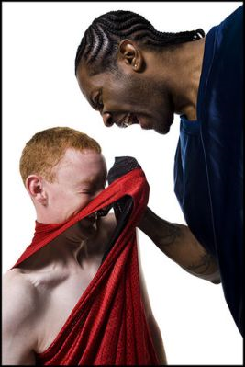
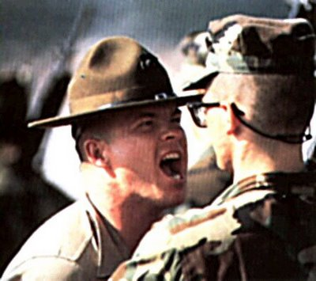



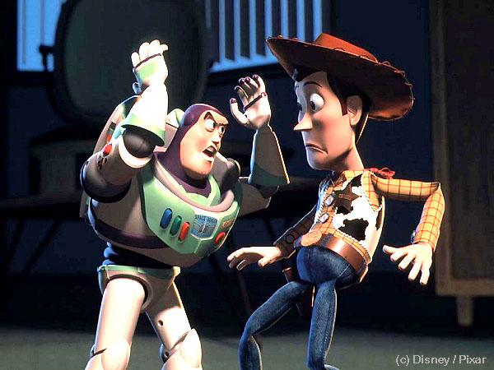

What is
Argument?

Slide 3
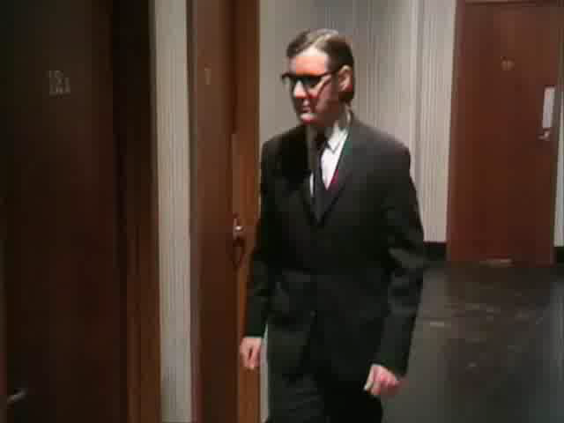

Slide 4

According to Monty Python
-It isn’t just contradiction.
-It isn’t just saying “No, it isn’t.”
+It is an intellectual process.
+It is a collective series of statements to establish a definite proposition.

Slide 5
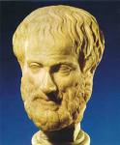

Aristotle
Notes:
Lived 300 years BC
Greek philosopher
Wrote extensively: theater, poetry, metaphysics, physics, biology, zoology, music, gov’t, ethics, AND logic/rhetoric

Slide 6
Speaker/Writer
(Rhetor)
Ethos
Context
Intent/ Purpose
Subject
Audience
Logos
Pathos

Slide 7
The AP Exam
Multiple Choice
1 hour
Synthesis
15 min
+
40 min
Analysis
40 min
Argument
40 min

Slide 8
Steps to Take
On the AP Exam

Slide 9
The Three Steps
Understand the prompt
Take a stand
Support your position

Slide 10
Plan, Plan, Plan!

Slide 11
1. Understand the Prompt
Read carefully
Highlight important words
Determine if a position is being taken

Slide 12
2. Take a Stand
Do I AGREE with the position?
Do I DISAGREE with the position?
Do I want to QUALIFY the position?
Embrace COMPLEXITY!

Slide 13
Defend, Challenge, or Qualify?
Defend - You agree with what is written. All your evidence supports this viewpoint.
Challenge – You disagree with what is written. All your evidence disproves the viewpoint.
Qualify – You agree with part of the view and disagree with part of it. Your evidence both supports and refutes the provided viewpoint.

Slide 14
Defend, Challenge, or Qualify?
Honesty is the best policy.
Killing people is wrong.
People should never break laws.

Slide 15
A Rose by Any Other Name…
“Write an essay in which you evaluate the pros and cons of corporate sponsorship…”
“Write an essay that examines the extent to which Paine’s characterization of America holds true today…”

Slide 16
3. Support Your Position
Learned
Seen
Done
Cultural knowledge
Historical events
Current events
Your own observations
What you’ve seen on TV, the internet,
heard on the radio
Personal experiences

Slide 17
What's Allowed
Facts
Statistics
Quotations
Dialogue
Definitions
Examples
Anecdotes
Anything that supports your position

Slide 18

How Do I Become Informed?
NPR on the way to/from school (89.7/90.9)
Watch the news on TV at night
cnn.com, foxnews.com,
boston.com, nytimes.com, washingtonpost.com
feedly, news360 apps
Talk to informed adults!

Slide 19
Tips and Tricks

Slide 20
What Will Be The Topic?
You may be asked to do almost anything, including:
Evaluate a statement or position
Propose a solution to a problem
Explain and take a side on a controversial issue

Slide 21
Tone and Approach
Make sure it is appropriate for your purpose
Will you be serious, silly, nostalgic, excited, indignant, satirical, pedantic, confident, etc…?

Slide 22
Who is Your Audience?
AP Readers are made up of HS Teachers and College Professors. That means you are writing for people who:
have studied literature and rhetoric
are curious about the world
know “stuff”
are adults!

Slide 23

Ladder of Abstraction
At the top of the ladder we have abstract concepts.
A good essay moves between the top and bottom of the ladder!
The bottom of the ladder has specific, concrete examples.
adapted from S.I. Hayakawa

Slide 24

Do Not, Do Not, Do Not:
Rely on literature
Analyze the prompt
Leave the essay unfinished
Rely on 5-paragraph organization
Write about things you do not understand
Simplify

Slide 25

Do, Do, Do:
Plan, plan, plan
Write about what you know
Use “I” when it really matters
Write a conclusion, even if you’re not finished

Slide 26
Let's Try One!
A weekly feature of The New York Times Magazine is a column by Randy Cohen called “The Ethicist,” in which people raise ethical questions to which Cohen provides answers. The question below is from the column that appeared on April 4, 2003.
  At my high school, various clubs and organizations sponsor charity drives, asking students to bring in money, food, and clothing. Some teachers offer bonus points on tests and final averages as incentives to participate. Some parents believe that this sends a morally wrong message, undermining the value of charity as a selfless act. Is the exchange of donations for grades O.K. ?
The practice of offering incentives for charitable acts is widespread, from school projects to fund drives by organizations such as public television stations, to federal income tax deductions for contributions to charities. In a well-written essay, develop a position on the ethics of offering incentives for charitable acts. Support your position with evidence from your reading, observation, and/or experience.

Slide 27
Group Work!
10 minutes
As a group, come up with 4-6 possible positions you could take on this position.
Decide, as a group, which position you want to take.
Think of 3-4 good examples you can use to support your position.
Come up with 1 counter-argument, and decide how you would negate it.
Write a thesis statement.

Slide 28
Rubric
And Sample Responses

Slide 29
More Group Work!
10 minutes
Look over the first essay (3A). As a group, identify what makes this a successful essay.
Think about things like: organization, use of evidence, diction and syntax, command of language, etc…
What lesson do you take from this essay that you will remember on test day?

Slide 30
General Advice
Audition pens. Get one you like writing with.
Bring your own watch!
Writing more is generally better.
Never write cute comments or cartoons to the readers – focus on your writing.
Never swear!

Slide 31

Questions?

Slide 32
Need a Copy?
If you would like to download your own copy of this powerpoint, go to
mrdehart.weebly.com

